Slide 1
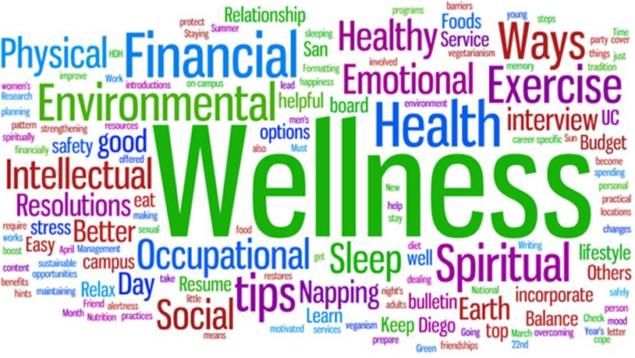

Slide 2
Overview
In the summer of 2016, a small group of veterinary mental health professionals and other key constituents gathered for an inaugural Think Tank to explore the challenges and opportunities of providing mental health and wellness services in veterinary academic settings. Many of us have been working alone for years, without access to a clearing house of resources, mentoring, or knowledge of the models of wellness services provided by each CVM. We’ve had few opportunities to discuss a collective identity, goals and objectives for our work, or how we can leverage our experience and expertise to best serve our population. Although many CVMs have now employed an onsite counselor, there have been few opportunities to discuss ideal practice models for our specific setting and population. Which programs are providing traditional counseling? Which programs have transitioned to a shorter term coaching and consulting model? Which programs offer both? What’s our shared vision? How do we articulate the ways our expertise benefits the veterinary profession as a whole? Even more fundamental, we realized we didn’t have a contact list of veterinary mental health providers at CVMs around the country; we had no easy way to welcome new hires into this unique specialization, communicate with each other, or share our experiences, struggles, triumphs, and resources.

Slide 3
Why?
At a time when health and wellness is a topic at the forefront of veterinary medicine, it’s more important than ever that veterinary mental health professionals are included in health, wellness, curriculum, career, and other related discussions at local, state, and national levels within the veterinary profession.
Immediately following the inaugural Think Tank, every effort was made to locate the names and contact information of veterinary mental health professional employed by CVMs and to share minutes from the Think Tank meeting. (Our guess is we still have names that we have not identified).
By coming together to identify a shared vision and focus united efforts on the wellbeing of those entering and/or working in the field of veterinary medicine, we can contribute to a more resilient and resourceful profession and a more robust identity as experts in our field. We can spend less time continuously reinventing the wheel, and more time partnering in a meaningful way with the population we serve and support.

Slide 4
What?
We are inviting all mental health professionals who work in CVMs to actively participate in Think Tank 2.0. We will share the outcomes of the inaugural Think Tank so that we are all starting from the same baseline and then engage in collaborative discussions toward forming a clear professional identity, vision, goals and objectives, explore common challenges and opportunities, brainstorm effective models of care, and consider how best to contribute our experience and expertise to local, state and national conversations on veterinary wellbeing.

Slide 5
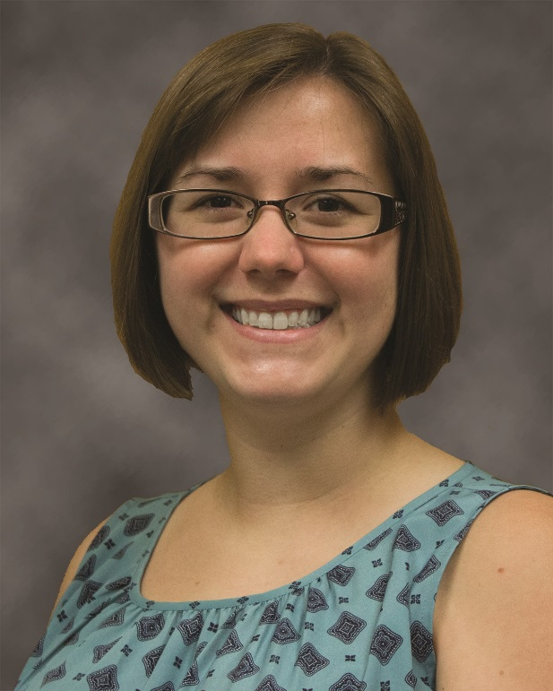
Bio
  Kayla H. Baudoin, LMSW, is an Academic Coordinator in the Office of Veterinary Education and Student Affairs at the Louisiana State University College of Veterinary Medicine. In 2010, she completed a B.S. in Psychology followed by a Master of Social Work in 2013, both at Louisiana State University. Mrs. Baudoin has obtained a Certificate in Gerontology and a Certificate Parenting Education for Parent Educators. Since 2014, Mrs. Baudoin has provided counseling and referral services for veterinary students, staff, and faculty. In addition, she pairs with the LSU School of Social Work mentoring current student interns and the LSU Lighthouse program to provide interpersonal violence prevention, advocacy, and support to the LSU campus community. Mrs. Baudoin does have a passion for research and continues to stay in contact with the LSU Life Course and Aging Center through publications and poster presentations.
Kayla H. Baudoin, LMSW
kholla1@lsu.edu
(O) 225-578-9537

Slide 6
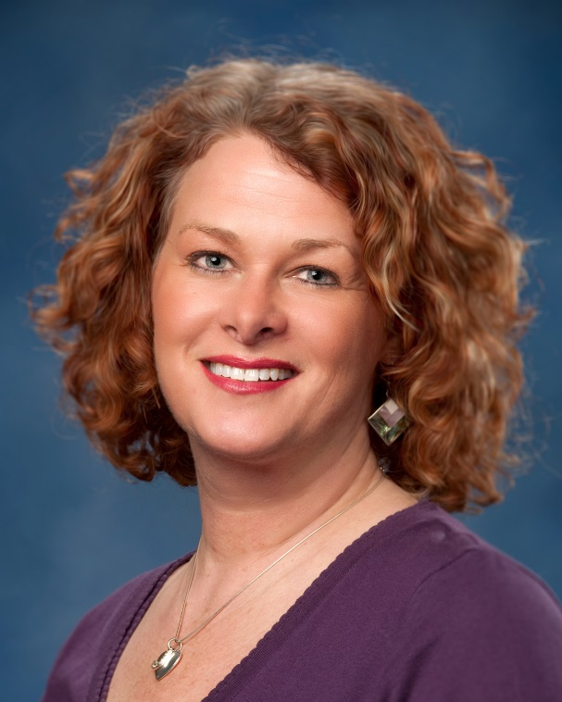
Bio
Dr. Jen Brandt is leading the effort to provide veterinary professionals with the communication, interpersonal and teamwork skills essential to quality veterinary care, veterinary career success, and life satisfaction. Her professional coaching, consultation and interpersonal skills training offer applied learning opportunities to increase self-awareness, improve wellness and resilience, resolve conflict, and enhance veterinary team communication. She has previously served as a medical social worker and educator.
Dr. Brandt is a nationally and internationally acclaimed guest lecturer at veterinary colleges and conferences and has served as a master trainer and facilitator for the Institute for Healthcare Communication since 2003. She received her master’s and doctoral degrees at Ohio State University and is the Director of Individual and Organizational Development at OSU.
Jen Brandt, MSW, PhD
brandt.61@osu.edu
(O) 614-292-6963

Slide 7
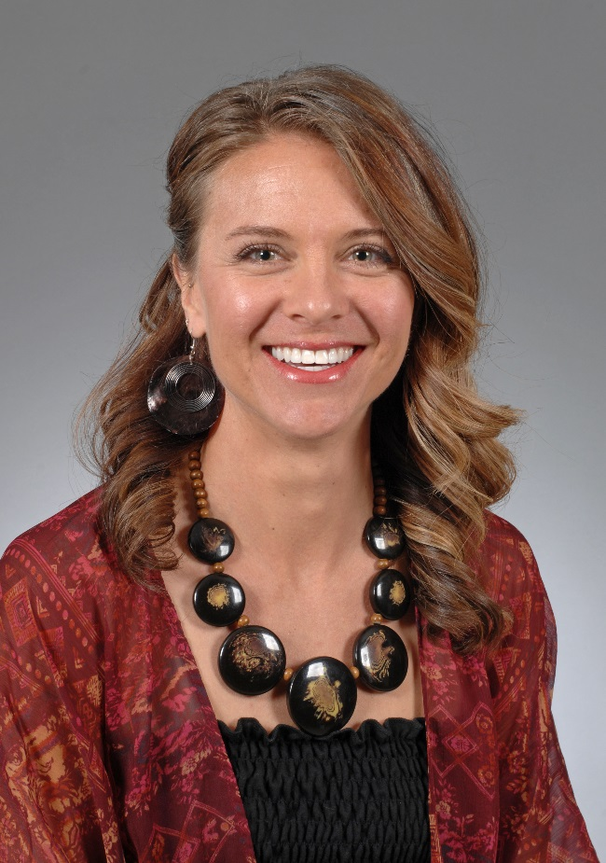
Bio
Bethany Colaprete is a Licensed Mental Health Counselor, School Psychologist, and certified Eating Psychology Coach. She works as a counselor, coach, and faculty in the College of Veterinary Medicine at Washington State University. She works individually with students and organizationally toward improving wellness.
She has additional training in the areas of Mindfulness and Focusing, and is an enthusiastic learner of neuroscience in mental health. Previous professional experience includes school counseling, community counseling, and in-patient mental health. Her approach to counseling and other wellness initiatives are strengths-based and holistic. She collaborates with WSU employees and universities around the nation to address mental health concerns in veterinary populations. For balance, Bethany spends time hiking, reading, traveling, baking, concert-hopping, swimming, and playing with her dog, Milo.
Bethany Colaprete, LMHC, EdS
bethanyc@vetmed.wsu.edu
  (O) 509-335-4709

Slide 8
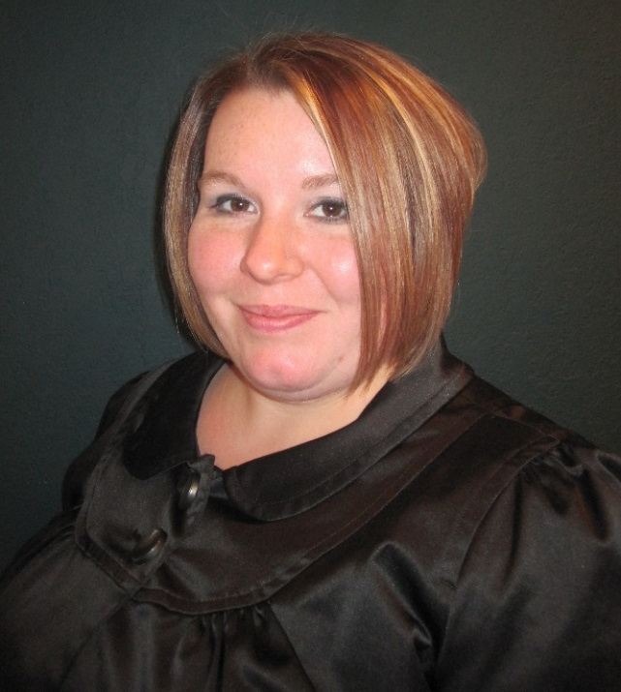
Bio
Athena earned her master of social work degree from the University of Minnesota in 2011 and is licensed at the Clinical level in the state of Minnesota. As an Intern in the University's Veterinary Social Services program, Athena learned from the founder of the program, discovering her calling and passion for veterinary social work. Athena attend to the "heart work" of veterinary medicine that was started at the Veterinary Medical Center many years ago. She is passionate about working with Veterinary Students in learning how to incorporate work/life balance into their careers, as well as educating on the importance of sustainable practice and self-care. She has a wide range of professional interests, including crisis intervention and debriefing, group work, and family medical therapy. She delivers training on the topic of human-animal relationships to veterinary professionals, animal welfare organizations, and social service providers throughout Minnesota.
Athena Diesch-Chham, MSW, LICSW
diesc009@umn.edu
(O) 612-625-4168

Slide 9
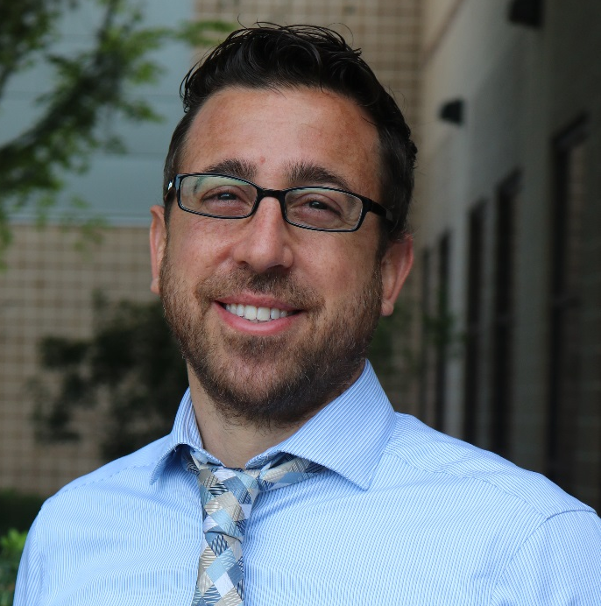
Bio
Dr. Ron Del Moro is a holistically minded licensed Mental Health Counselor providing counseling, wellness and education training with the University of Florida community since 2006. He holds a Specialist degree in Education, Master's degree in Couple, Marriage & Family Counseling and a Doctorate in Mental Health Counseling from the University of Florida.
Dr. Del Moro assists clients, students, faculty and staff at the University of Florida's College of Veterinary Medicine (UF CVM). He provides support and training for faculty, students and staff in communication, education, stress management, and coping with death and loss. Dr. Del Moro also creates and implements wellness initiatives at UF CVM. He is available to everyone in University of Florida's College of Veterinary Medicine's community for mediation, individual and couples counseling, group counseling, communication training, consultations, case debriefing, work-life balance and emotional support.
Ron Del Moro, PhD
rondel@ufl.edu
(O) 352-294-4430

Slide 10
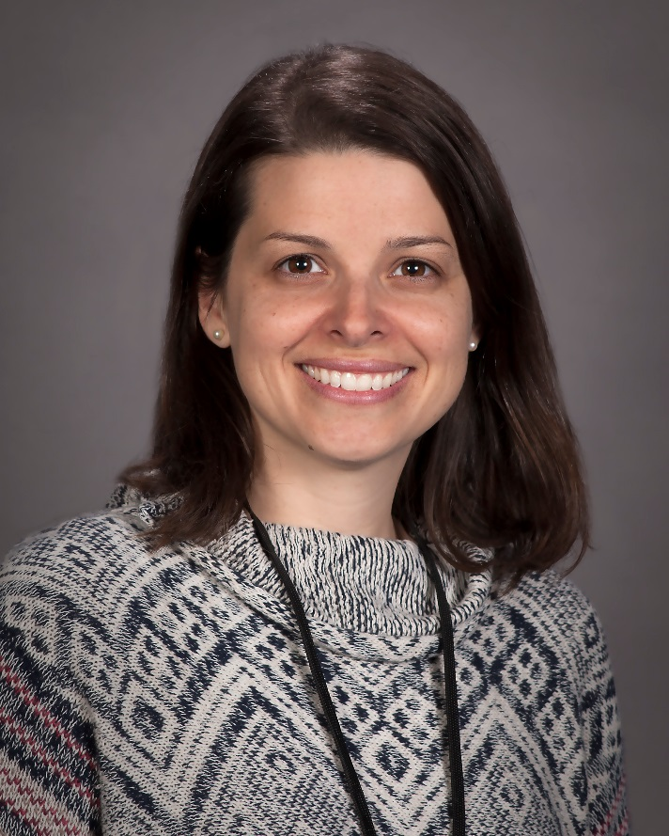
Bio
Elizabeth Eaton began working as the primary counselor at Texas A&M University CVM in December of 2016. Her background is in Clinical Social Work, and for the past ten years, worked with a wide range of client populations and clinical issues, from early childhood development to end-of-life hospice care. In the Wellbeing Services department at the CVM, she provides individual and couples counseling, consultation and wellness. Starting Fall of 2017, I will be teaching wellness curriculum embedded within a Professional Clinical Skills course. My areas of interest include developmental transitions across the lifecycle, identity development, family of origin, diversity issues, spirituality, healthy relationships, grief and loss, and wellness in veterinary medicine.
Elizabeth Eaton MSSW, LCSW
eeaton@scs.tamu.edu
(O) 979-845-0806

Slide 11
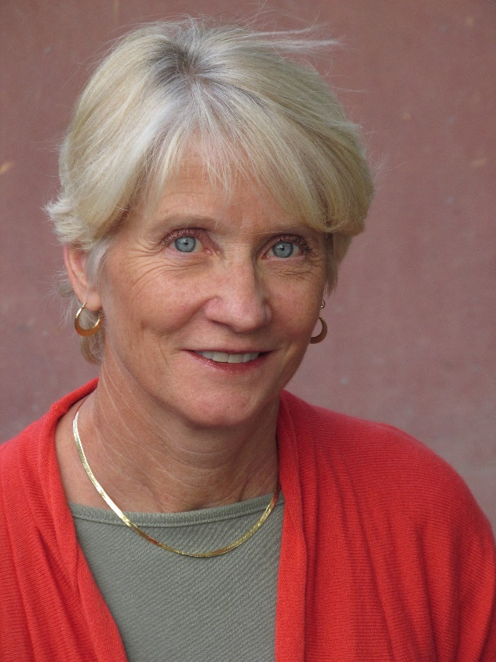
Bio
  Dr. Fonken, licensed psychotherapist, is a coordinator of DVM Counseling and Wellness Programs for the College of Veterinary Medicine and Biomedical Sciences at Colorado State University. She provides support and counseling services to students, interns and residents, oversees the wellness curriculum, coordinates the DVM orientation for incoming students, teaches courses, and directs and teachers the Healer’s Art Course.
  Over the last 30 years she has worked in private practice, clinical hospitals, and non-profit, governmental and educations settings.
  She is involved in AVMA Wellness Roundtable, Veterinary Wellbeing Think Tank, and overseeing planning and implementation of the 2016 AAVMC
  Veterinary Health and Wellness Summit Conference.
  As a Colorado native she spends time in nature, loves trail running, and enjoys outdoor adventures with her two sons.
Laurie Fonken, LPC, PhD
Laurie.Fonken@ColoState.edu
(O) 970-491-3919

Slide 12
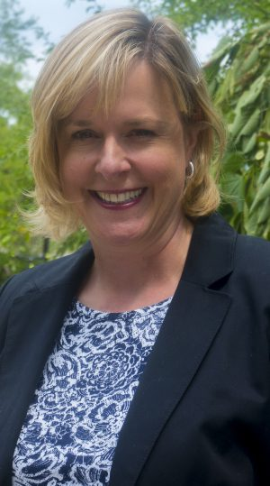
Bio
Chandra Grabill is a licensed psychologist and the Assistant Dean for Student Wellness and Engagement in the Michigan State University College of Veterinary Medicine (MSU-CVM). She is responsible for several programs that support student success in the college, including tutoring and wellness-related activities. Before moving into her current administrative role, she provided counseling to students in the DVM and the Veterinary Technology programs, as well as mental health-related consultation services for the college community. She is also a faculty advisor MSU-CVM Pet Loss Support Hotline.
Dr. Grabill received her PhD in Clinical Psychology from Kent State University. After this, she completed a postdoctoral fellowship at the Emory University School of Medicine. She is grateful to use her training to advance the “human” side of veterinary medicine.
Chandra Grabill, PhD
grabillc@cvm.msu.edu
(O) 517-432-7784

Slide 13
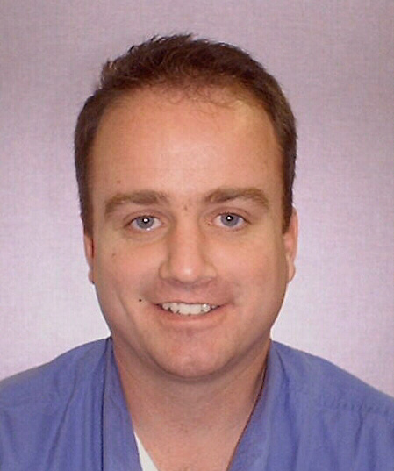
Bio
McArthur “Mac” Hafen is Director of Counseling Services at Kansas State University’s College of Veterinary Medicine. He’s worked at K-State for 12 years coming to the university from training nursing students. He has a doctorate in Marriage and Family Therapy. He has authored numerous manuscripts highlighting veterinary medical student wellness. Helping students find success and relief from stress and anxiety is his passion. He also teaches communication skills.
MacArthur Hafen, LMFT, PhD
mhafen@vet.ksu.edu
(O) 785-532-4448

Slide 14
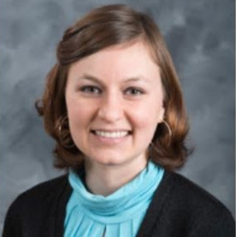
Bio
Chelsey Hess-Holden is a Licensed Marriage and Family Therapist working as a Graduate Assistant for the Student Counseling Services housed at the College of Veterinary Medicine at Mississippi State University. She is a third-year PhD student in Counselor Education and has worked at MSU’s CVM since June 2015. She provides individual, couples, and group therapy to Doctor of Veterinary Medicine and Veterinary Technology students, as well as workshops and training on a variety of mental health and veterinary wellness topics.
Chelsey Hess-Holden, LMFT, PhD candidate
chess@saffairs.misstate.edu
  (O) 662-325-2901

Slide 15
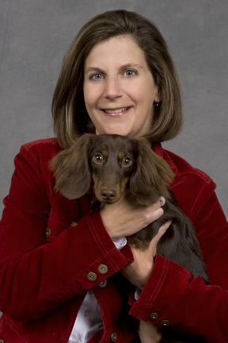
Bio
Stephanie W. Johnson is an Assistant Professor in the Department of Veterinary Clinical Science and maintains an appointment in the Office of Veterinary Education and Academic Affairs at the Louisiana State University School of Veterinary Medicine. She has been employed by the in the Office of Veterinary Education and Academic Affairs since 1990 where she provides counseling and referral services for veterinary students, staff and faculty.
For the last 26 years, Stephanie has specialized in the area of the Human Animal Bond and Grief, both counseling clients and lecturing to veterinarians, students and the public. She teaches grief and loss, communication skills, and life balance and facilitates throughout the four years of the veterinary curriculum. She also supervises an intern from the LSU School of Social Work Masters program and Graduate Social Workers working toward licensure.
Stephanie Johnson, LCSW
sjohn17@lsu.edu
(O) 225-578-9537

Slide 16
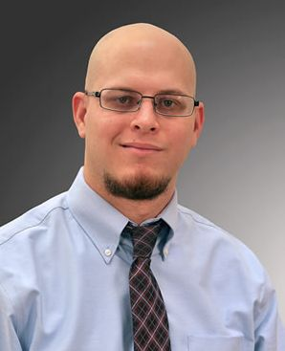
Bio
Dr. Kerry Karaffa is a licensed psychologist and mental health and wellness coordinator with the University of Missouri Counseling Center and College of Veterinary Medicine. He earned a M.S. in Psychology from Texas A&M University-Commerce and a Ph.D. in Counseling Psychology from Oklahoma State University and completed his doctoral internship in professional psychology at the University of Missouri Counseling Center. He has experience providing clinical services in community mental health and university counseling center settings, and he practices from an integrative perspective that is informed primarily by pragmatic psychodynamic and systems theories. Dr. Karaffa provides counseling, crisis intervention and consultation services to students, interns, and residents affiliated with the MU CVM and conducts research related to mental health and wellness in the veterinary community. His current research interests include mental health stigma and barriers to seeking mental health services, mental health and wellness in veterinary medicine, organizational dynamics, and social support.
Kerry Karaffa, PhD
karaffak@missouri.edu
(O) 573-882-4629

Slide 17
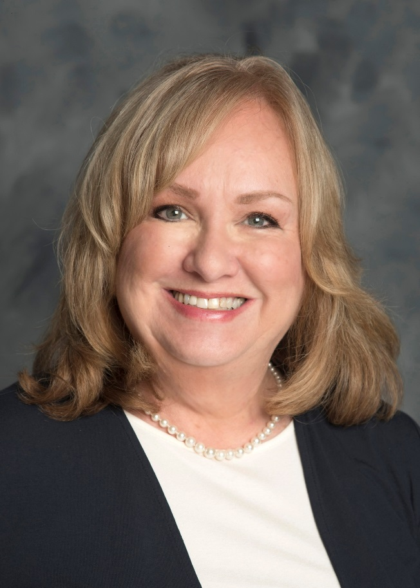
Bio
Dr. Christy Monaghan is a Licensed Psychologist and is licensed to practice in Mississippi and in Florida, where she previously worked for a number of years in private practice. She is currently employed as Staff Psychologist and Coordinator of Clinical Services and Training at MSU’s College of Veterinary Medicine, as a satellite office for MSU Student Counseling Services. Dr. Monaghan works full-time for CVM and is housed on-site. She initiated the first on-site counseling and psychological services at MSU CVM in October 2014 and continues to work toward the development of a model mental health program for veterinary students in training.
Christy Monoghan, PhD
CMonaghan@saffairs.msstate.edu
(O) 662-325-1195

Slide 18
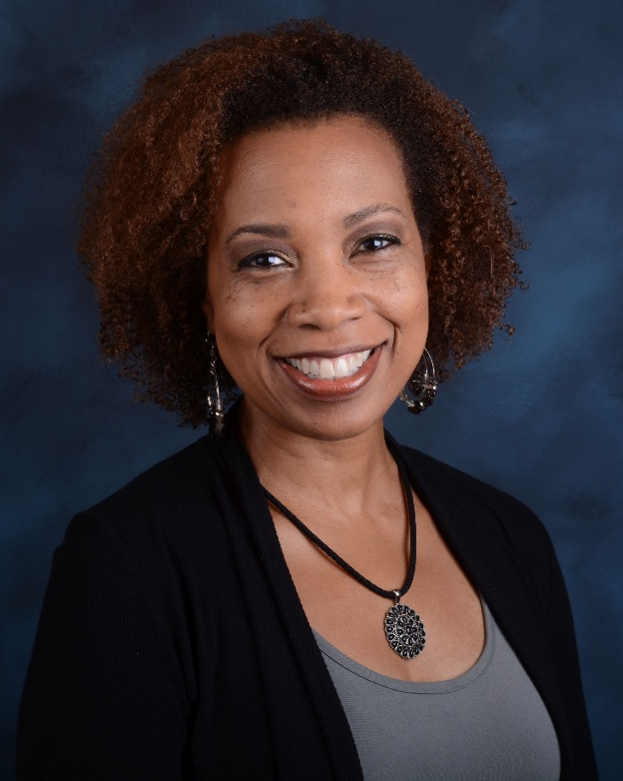
Bio
Dr. Chiarina Owens is on staff with the Michigan State University College of Veterinary Medicine. She provides counseling and wellness services for students in the DVM and Veterinary Technology programs. She is a licensed psychologist who earned her Ph.D. in Clinical Psychology from Wayne State University and completed a postdoctoral fellowship in Pediatric Neuropsychology at Case Western Reserve University School of Medicine. Throughout her career, she has worked in a diverse range of clinical settings, including general and specialty hospitals, schools, forensic settings, and outpatient mental health. At CVM, Dr. Owens provides consultations and counseling to DVM and Vet Tech students, along with consultations with faculty and staff about student concerns. She has a strong commitment to personal and professional wellness in the Veterinary Science community.
Chiarina Owens, PhD
owenschi@msu.edu
(O) 517-432-7782

Slide 19
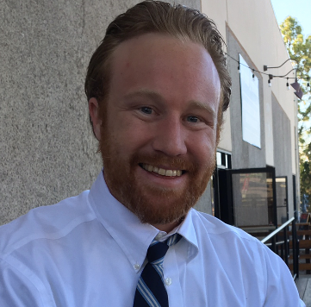
Bio
Hello, my name is Alex Rowell and I work for both Counseling and Psychological Services (CAPS) and the College of Veterinary Medicine (CVM) at OSU. I have clinical experiences that include three different inpatient/outpatient hospitals, a non-profit organization, and three different college-counseling centers. My areas of interests include working with professional/graduate students, mood disorders, self-compassion, grief, mindfulness, burnout, gender awareness and education, and life transitions. I have presented on the local, state, and national levels on peripartum mental health and couples transition to parenthood. I practice from a Humanistic, ACT, CBT, and Self-Psychological perspective. I enjoy having a collaborative and working relationship with my clients to truly understand how current problems may be hindering everyday life situations. I also enjoy running, playing with my three dogs, and being outdoors in my spare time.
Alex Rowell, PsyD
alex.rowell@oregonstate.edu
(O) 541-737-9214

Slide 20
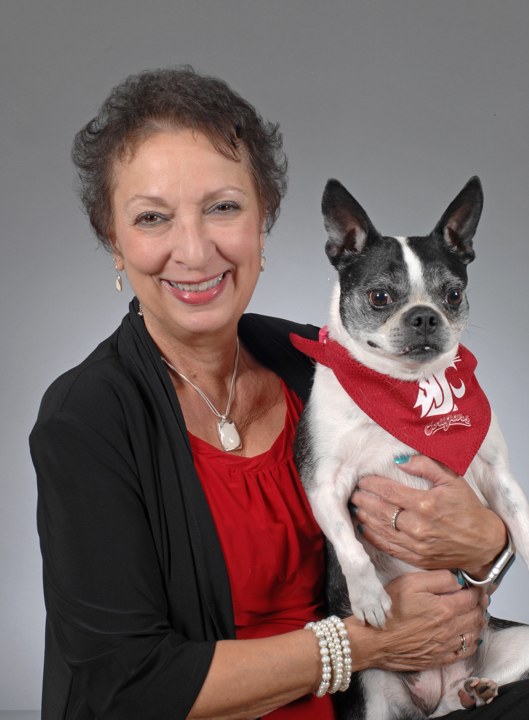
Bio
Valerie Russo, PhD LPC LMHC is a professional counselor, life-coach, and faculty at Washington State University College of Veterinary Medicine. Creativity and enthusiasm mark her eighteen years serving students in northwest university communities. Dr. Russo holds a Doctorate in Higher Education Administration with and emphasis in Psychology and Health and Wellness. Her Master’s Degree in Clinical Psychology provided the framework of a health belief model that has influenced much of her work with students and clients to encourage, motivate, balance, provide tools, and guide strategies for healthy success. Dr. Russo has a desire to work in a team-centered approach that focuses on all aspects of student wellness and mental health care. She enhances diverse student’s abilities to successfully engage complex social, academic, and ethical challenges. Her teaching goals include providing information and experiences that contribute to a student’s professional development and overall well-being.
Valerie Russo, LMHC, PhD
vrusso@vetmed.wsu.edu
  (O) 509-335-4706

Slide 21
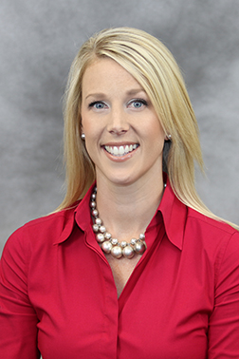
Bio
Stevie Stigler joined the CAPS staff in 2013. She serves as the embedded mental health clinician for both the College of Veterinary Medicine and the Veterinary Teaching Hospital. She earned a BS in Psychology from Georgia College and a MA in Professional Counseling from the Georgia School of Professional Psychology/Argosy University. Stevie is a Licensed Professional Counselor trained as a clinical generalist, who holds a premier certification titled National Certified Counselor (NCC). This certification demonstrates to colleagues and the public that you have voluntarily met high national standards for the practice of counseling. Her clinical interests include identity development, stress management, the challenges of adjustment, anxiety, depression, interpersonal concerns, and psychoeducation/outreach programs. Stevie’s methodology of service is supportive, creative, and inviting. She believes in a collaborative treatment approach and utilizes a variety of techniques to aid in the client’s journey of personal growth.
Stevie Stigler, LPC
sstigler@uhs.uga.edu
(O) 706-542-2273

Slide 22
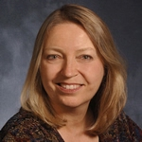
Bio
Betsy Taylor, PhD, is a licensed Psychologist and provides counseling services at North Carolina State University College of Veterinary Medicine. Likes Mexican food, all dogs, and is learning to play the guitar, though still sounds pretty bad :)
Betsy Taylor, PhD
betsy_taylor@ncsu.edu
(O) 919-513-6008

Slide 23
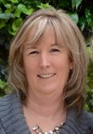
Bio
I have been with UCVM for 10 years. I have been part of the faculty prior to having students and many faculty members. UCVM has grown very quickly and is adapting to change and student needs.
I have been the Student Experience Advisor for over 3 years. My role encompasses all things student related that are not academic. I work with Student Clubs, University Wellness Centre, Mentorship programs and Student Awards. I am also the support for students with academic challenges and help them navigate the support which they require to become successful veterinarians.
Janet Webb
janet.webb@ucalgary.ca
(O) 403-210-6206

Slide 24
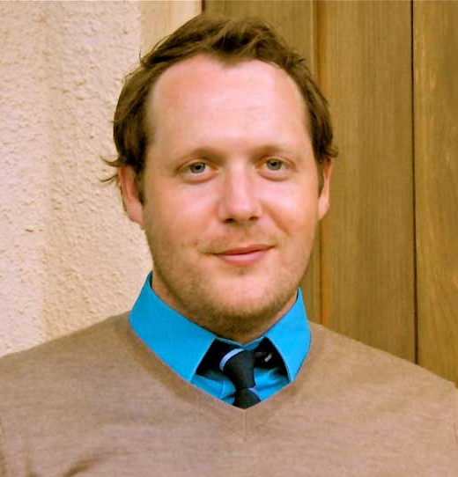
Bio
Dr. Ward is a Licensed Psychologist and Coordinator of Mental Health and Wellness Programs for the School of Veterinary Medicine at UC Davis. Dr. Ward provides direct clinical services, psycho-educational programming, and consultation to students, faculty, and staff as part of the Career, Leadership, and Wellness Center at the School of Veterinary Medicine.
Dr. Ward received his master's and doctoral degrees from Texas Tech University. He has worked in several mental health contexts. College mental health has been a primary focus for many years, and veterinary student mental health has been a significant part of that focus since 2011.
Zach Ward, PhD
zward@shcs.davis.edu
(O) 530-752-0871

Slide 25
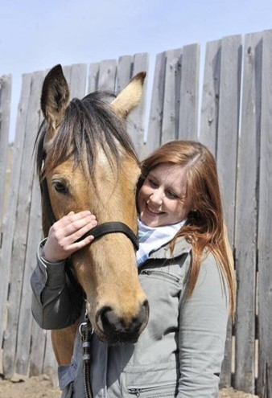
Bio
Erin is a registered MSW social worker. She has clinically worked in a number of areas of social work. She has spent her career working with individuals, groups, and communities as an advocate, clinician, and resource to promote resiliency. Her holistic approaches center on biological, psychological, social and spiritual assessment and intervention combined with theory and practice approaches that explore the reasons why individuals connect and disconnect relationally in their lives.
Erin implemented the Veterinary Social Work services at the University of Saskatchewan, Western College of Veterinary Medicine (WCVM). She provides services to clients and resources to staff, faculty, and students. She has been active in the promotion of health, wellbeing, and self-care strategies with veterinarians. She has been providing resources to professional associations, animal protection agencies, and other groups who interact with human and animal relationships.
Erin Wasson
erin.wasson@usask.ca
(O) 306-966-2852

Slide 26
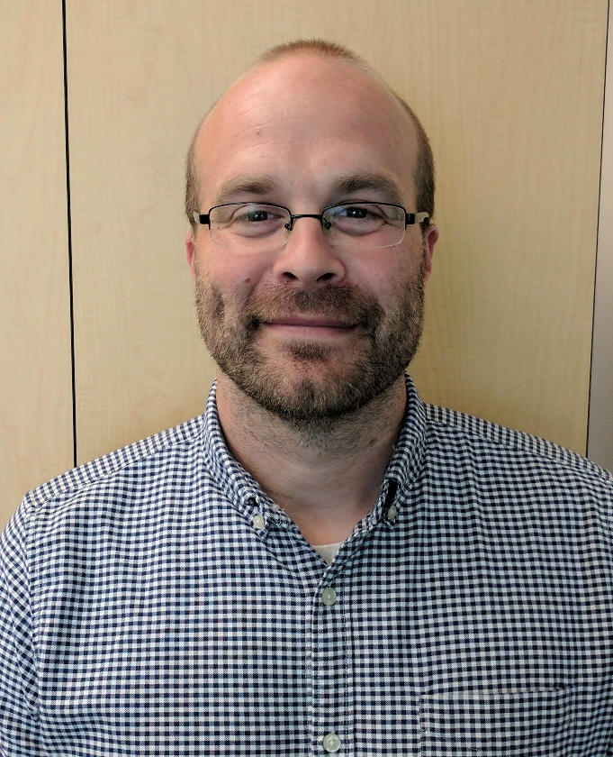
Bio
Dr. Chapman is a Licensed Psychologist and Director of Counseling and Wellness at the Utah State University Veterinary Medicine Program. He also holds a position as Group Coordinator at the Utah State University Counseling Center. Dr. Chapman has spent 3 years working with veterinary students and has focused on helping students find the balance and skills they need to succeed in their schooling and future profession. Dr. Chapman provides counseling, coaching, workshops, didactic presentations, and assists other faculty in the teaching of courses related to Ethics and clinical communication skills.
Dr. Chapman received his Doctorate in Clinical Psychology from Brigham Young University. He enjoys backpacking, hiking, boating, and going on adventures when he has the opportunity.
Chris Chapman
chris.chapman@usu.edu
(O) 801-792-1459

Slide 27
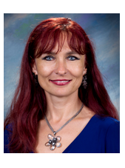
Bio
Dr. Luana Nan, is a psychologist licensed to practice in Indiana and Illinois. Much of her training and professional experience has been in working with college students. Dr. Nan joined the Purdue College of Veterinary College in 2013, and has been providing counseling and wellness services to veterinary students, interns and residents since then. Dr. Nan has a passion for supporting students while they navigate a very demanding program in a way that promotes their success, personal growth and well-being. She is also very committed to contributing to building a diverse and inclusive professional culture that recognizes and honors the symbiosis between professional excellence and personal wellness.
Luana Nan
nanl@purdue.edu
(O) 765-494-7893

Slide 28
Bio
Name
email@xxxx.xxx
(O) XXX-XXX-XXXX

Slide 29
Bio
Name
email@xxxx.xxx
(O) XXX-XXX-XXXX

Slide 30
Bio
Name
email@xxxx.xxx
(O) XXX-XXX-XXXX

Slide 31
Bio
Name
email@xxxx.xxx
(O) XXX-XXX-XXXX

